Slide 1
Secure coding
--Sri Harsha, CyberEye.

Slide 2
Secure coding in C
Since the language provides few guarantees, developers must use discipline
Good reference guide: CERT C Coding Standard
https://www.securecoding.cert.org/confluence/display/seccode/CERT+C+Coding+Standard
See also: David Wheeler: http://www.dwheeler.com/secureprograms/Secure-Programs-HOWTO/internals.html
And Matt Bishop: http://nob.cs.ucdavis.edu/bishop/secprog/robust.html
Combine with advanced code review testing - techniques like static program analysis, buzz testing and symbolic execution.

Slide 3
Design vs. implementation
In general, we strive to follow principles and rules
A principle is a design goal with many possible manifestations
A rule is a specific practise that is consonant with sound design principles
Difference between these can sometimes be fuzzy
Here we look at rules for good C coding
In particular, to avoid implementation errors that could result in violations of memory safety

Slide 4

Rule: Enforce input compliance
char digit_to_char(int i) {
char convert[] = “0123456789”;
if ( i<0 || i>9)
return ‘?’;}
Possible
overflow
possible
Unfounded trust in received input is a recurring
source of vulnerabilities!
ovflow

Slide 5
General principle: Robust coding
Like defensive driving
Avoid depending on anyone around you
If someone does something unexpected, you won’t ceash (or worse)
It’s about minimizing trust
Each module pessimistically checks its assumed preconditions (on outside callers)
Even if you “know” clients will not send a NULL pointer
…. Better to throw an exception (or even exit) than run malicious code
http://nob.cs.ucdavis.edu/bishop/secprog/robust.html

Slide 6
Rule: Use safe string functions
Traditional string library routines assume target buffers have sufficient length
•
char str[4];!
char buf[10] = “fine”;!
strcpy(str,”hello”); // overflows str
strcat(buf,”day to you”); // overflows buf
•
Safe versions check the destination length
char str[4];!
char buf[10] = “fine”;!
strlcpy(str,”hello”,sizeof(str)); //fails
strlcat(buf,”day to you”,sizeof(buf));//fails

Slide 7
Replacements
…. for string-oriented functions
strcat ⇒ strlcat
strcpy ⇒ strlcpy
strncat ⇒ strlcat
strncpy ⇒ strlcpy
sprintf ⇒ snprintf
vsprintf ⇒ vsnprintf
gets ⇒ fgets
Microsoft versions different
strcpy_s, strcat_s, ….

Slide 8
Rule: Don’t forget NUL terminator
•
Strings require one additional character to store the
NUL terminator. Forgetting that could lead to overflows
char str[3];!
strcpy(str,”bye”); // write overflow!
int x = strlen(str); // read overflow
•
Using safe string library calls will catch this mistake
char str[3];!
strlcpy(str,”bye”,3); // blocked!
int x = strlen(str); // returns 2

Slide 9
Rule: Understand pointer arithmetic
•
sizeof() returns number of bytes, but pointer arithmetic multiplies by the sizeof the type
int buf[SIZE] = { … };!
int *buf_ptr = buf;!
!
while (!done() && buf_ptr < (buf + sizeof(buf))) {
*buf_ptr++ = getnext(); // will overflow!
}
So, use the right units
•
while (!done() && buf_ptr < (buf + SIZE)) {!
*buf_ptr++ = getnext(); // stays in bounds!
}

Slide 10

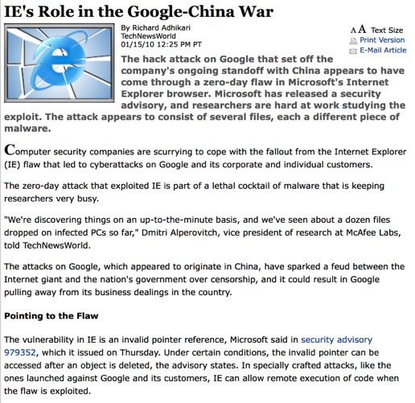







Defend dangling pointers
int x = 5;
int *p = malloc(sizeof(int));
free(p);
int **q = malloc(sizeof(int*)); //reuses p’s space
*q = &x;
*p = 5;
**q = 3; //crash (or worse)
x:
5
5
p:
q:
?
?
?
#

Slide 11

Rule: Use NULL after free
int x = 5;
int *p = malloc(sizeof(int));
free(p);
p = NULL; //defend against bad deref
int **q = malloc(sizeof(int*)); //reuses p’s space
*q = &x;
*p = 5; //(good) crash
**q = 3;
x
⁵
P
q
?
?
#
⁰
?
Stack
Heap

Slide 12
Manage memory properly
int foo(int arg1, int arg2) {
struct foo *pf1, *pf2;
int retc = -1;
pf1 = malloc(sizeof(struct foo));
if (!isok(arg1)) goto DONE;
…
pf2 = malloc(sizeof(struct foo));
if (!isok(arg2)) goto FAIL_ARG2;
…
retc = 0;
FAIL_ARG2:
free(pf2); //fallthru
DONE:
free(pf1);
return retc;
}
Rule: Use goto
chains to avoid duplicated or missed code!
Encodes try/
finally in
languages like
Java
•
•
Confirm your logic!
•
•
Gotofail bug

Slide 13
(Better) Rule: Use safe string library
Libraries designed to ensure strings used safely
Safety first, despite some performance loss
Example: Very Secure FTP (vsftp) string library!
struct mystr; // impl hidden
void str_alloc_text(struct mystr* p_str,
const char* p_src);
void str_append_str(struct mystr* p_str,
const struct mystr* p_other);
int str_equal(const struct mystr* p_str1,
const struct mystr* p_str2);
int str_contains_space(const struct mystr* p_str);
http://vsftpd.beasts.org/
Another example: C++ std::string safe string library

Slide 14
Rule: Favor safe libraries
Libraries encapsulate well-thought-out design.
Smart pointers
Pointers with only safe operations
Lifetimes managed appropriately
First in the Boost library, now a c++ 11 standard
Networking: Google protocol buffers, Apache Thrift
For dealing with network-transmitted data
Ensures input validation, parsing, etc.
Efficient

Slide 15
Rule: Use a safe allocator
ASLR challenges exploits by making the base address of libraries unpredictable
Challenge heap-based overflows by making the addresses returned by malloc unpredictable
Can have some negative performance impact
Example implementations:
Windows Fault-Tolerant Heap
http://msdn.microsoft.com/en-us/library/windows/desktop/dd744764(v=vs.85).aspx
Diehard (on which fault-tolerant heap is based)
http://plasma.cs.umass.edu/emery/diehard.html

